Slide 1
DISCRETE MATHEMATICS
Department of Mathematics
SSN College of Engineering (Autonomous)

Slide 2
Module 1.1
PRE-CLASS CONTENT
LOGIC
Propositional Logic

Slide 3
Logic
What is LOGIC?
The term “Logic” came from Greek word “logos”, which is sometimes translated as “sentence”, “discourse”, “reason”, “rule’ and “ratio”.
The Greek word “logos” means ‘thought’. There are many thought processes such as “reasoning”, “remembering”, “imagining”. Reasoning is a thought process in which inference takes place. Logic is the science of reasoning.
Logic is the basis of all Mathematical reasoning and of all automated reasoning. The rules of logic specify the meaning of Mathematical statements.

Slide 4
Mathematical Logic
Importance of Mathematical Logic
The rules of logic give precise meaning to mathematical statements. These rules are used to distinguish between valid and invalid mathematical arguments.
Apart from its importance in understanding Mathematical reasoning, Logic has numerous applications in Computer Science, varying from design of digital circuits to the construction of computer programs and verification of correctness of programs, Artificial intelligence, Automata theory, etc.

Slide 5
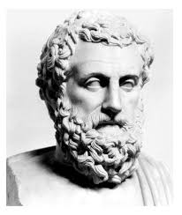
History of Logic
Logic was ﬁrst developed by Aristotle (384-322 BCE).
Aristotelian logic became widely accepted in Science and Mathematics and remained in wide use in the west until the early 19th century.
Aristotle's system of logic was responsible for the introduction hypothetical syllogism, temporal modal logic and the inductive logic.

Slide 6
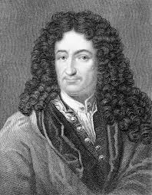
Development of Logic
The ﬁrst important name in the development of modern symbolic logic is that of G.W Leibnitz (1646-1716).
The real development of this Calculus began only in the mid 19th century and was initiated by the research done by the English Mathematician G. Boole, who is sometimes regarded as the founder of Mathematical logic.
Other important logicians who contributed to the development of symbolic logic include Augustus de Morgan (1806-1871), W.S Jevons (1835-1882) and C.S Peirce (1839-1914).

Slide 7
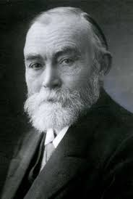
Components of Logic
There are two main components of logic
Propositional logic or propositional calculus
Predicate logic or Predicate calculus
Propositional logic deals with analysis of propositions where as Predicate logic deals with predicates which are prepositions containing variables.
The classical Propositional logic was first formulated as a formal axiomatic system by the eminent German logician G. Frege in 1879.
The study of Propositional logic consists of syntax (grammar), sematics (meaning), inference rules and derivation.

Slide 8
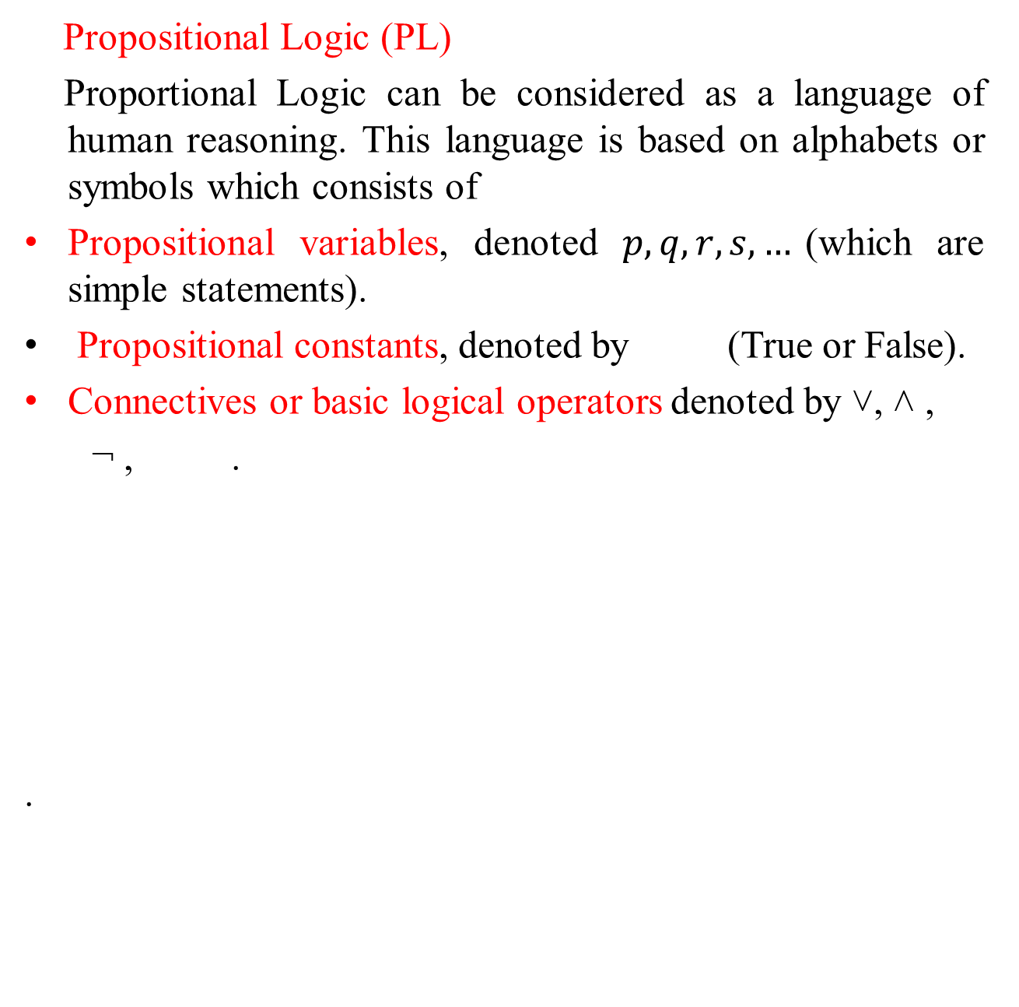
Propositional Logic
Propositional Logic (PL)
Proportional Logic can be considered as a language of human reasoning. This language is based on alphabets or symbols which consists of
Propositional variables, denoted $p,q,r,s,…$(which are simple statements).
Propositional constants, denoted by (True or False).
Connectives or basic logical operators denoted by ˅, ˄ ,
¬ , .
.

Slide 9
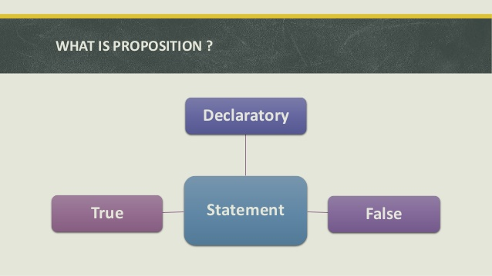
Proposition
A proposition is the basic building block of logic.
It is defined as a declarative sentence that is either True or False but not both.
The Truth Value of a proposition is True (denoted as T) if it is a true statement and False (denoted as F) if it is a false statement

Slide 10

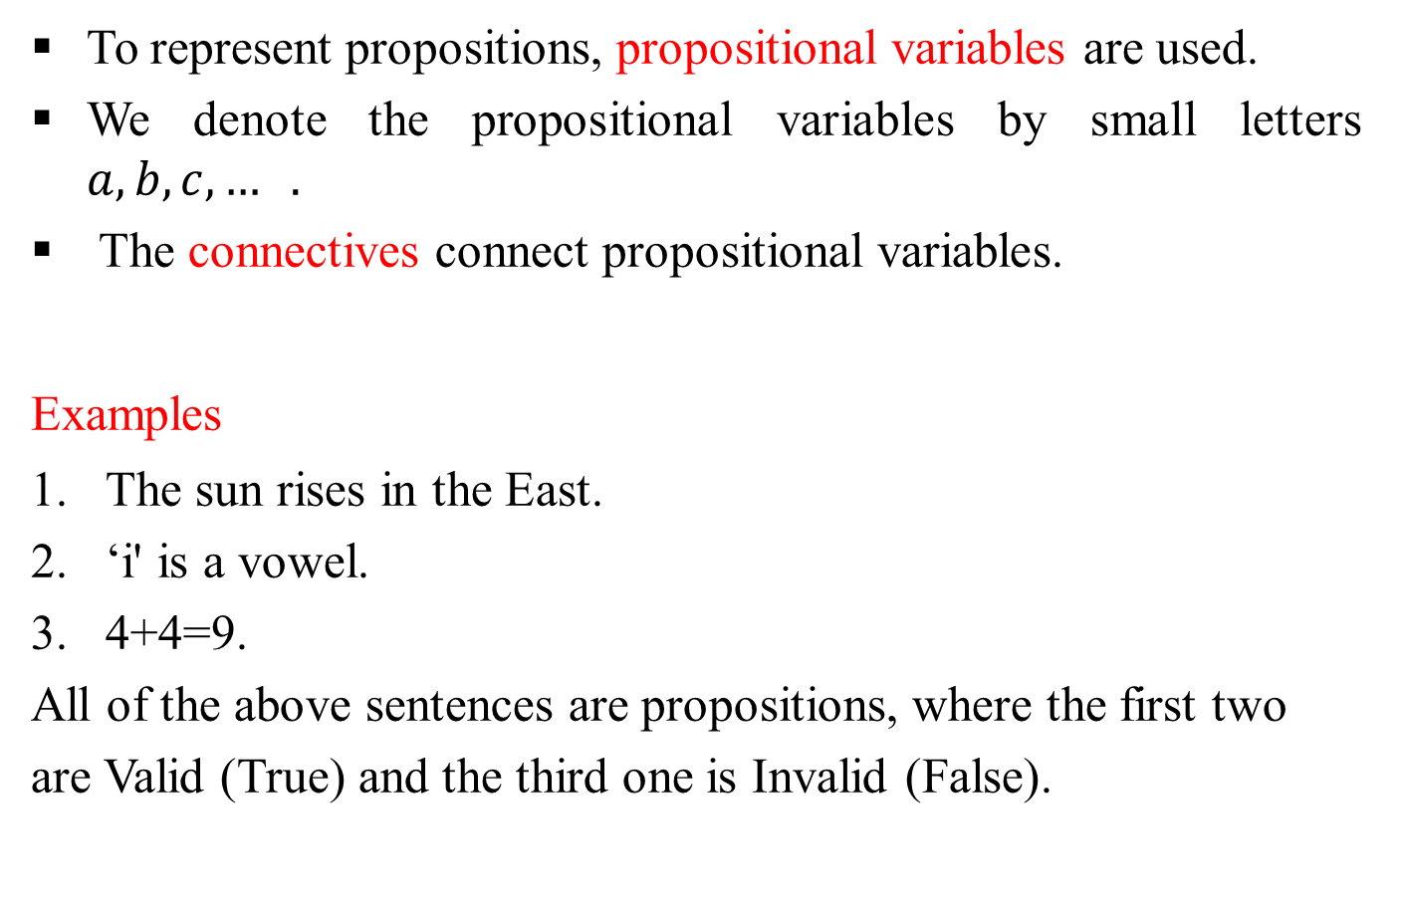
To represent propositions, propositional variables are used.
We denote the propositional variables by small letters $a,b,c,… .$
The connectives connect propositional variables.
Examples
The sun rises in the East.
‘i' is a vowel.
4+4=9.
All of the above sentences are propositions, where the first two
are Valid (True) and the third one is Invalid (False).

Slide 11
The following sentences are not propositions
What a wonderful place this is ! (Exclamatory sentence)
What is the height of Mount Everest? (Interrogative sentence)
Obey my words (command)
x+2=4
Since these sentences are not propositions, we cannot assign true or false.
Primary statements
A declarative sentence which cannot be further split up into simple sentences are called Primary statements or Atomic statements or Primitive statements.

Slide 12
Connectives
Connectives is an operation which is used to connect two or more than two statements. It is also known as Logical connectives or Logical operators.
Compound proposition
Statements which contain one or more primary statements and some connectives are called Compound or Molecular or Composite statements.
Truth table
Since we need to know the truth value of a proposition in all possible scenarios, we consider all the possible combinations of propositions which are joined together by logical connectives to

Slide 13
form the given compound proposition. This compilation of all possible scenarios in a tabular format is called a Truth table.
BASIC CONNECTIVES
Logical connectives | Name | Symbols | Type of operator
Not And | Negation Conjunction | ~ ˅ | Unary Binary
Or | Disjunction | ˄ | Binary
If … then | Conditional |  | Binary
If and only if | Biconditional |  | Binary

